Slide 1
Apologetics… Defending the Faith
Scripture in Support of Our Catholic Beliefs
Lesson 4 – Mary, or Where is That in the Bible?
Notes:
We’ve gone over the definition of apologetics and why we should all endeavor to be at least somewhat proficient at it. Then we covered the misunderstandings between the Protestant and Catholic versions lf the ten commandments, and finally the issues abut idolatry and the actual teachings of the Church and the practices of Catholics.

Slide 2
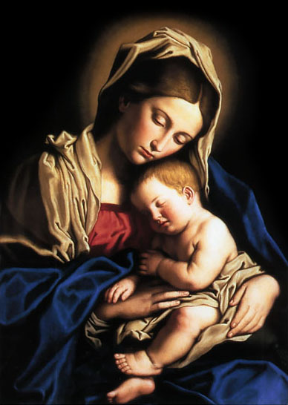
The Catholic Teachings About Mary
The Immaculate Conception
Perpetual Virginity
As Ark of the New Covenant
The Assumption of Mary
Mary Queen of Heaven
Notes:
We Catholics put a lot of emphasis on honoring Mary. While all Christians acknowledge her as the Mother of Jesus, many non Catholic Christians discount the emphasis that Catholics put on her and even deride Catholics for worshipping her as a deity.
Last session we talked about Her perpetual virginity, and her immaculate conception.

Slide 3
The Catholic Teachings About Mary
As Ark of the New Covenant
The Assumption of Mary
Mary Queen of Heaven
Notes:
This week we’ll cover her roll as the Ark of the New Covenant, her assumption into heaven and finally her eternal place of honor as Queen of Heaven.

Slide 4
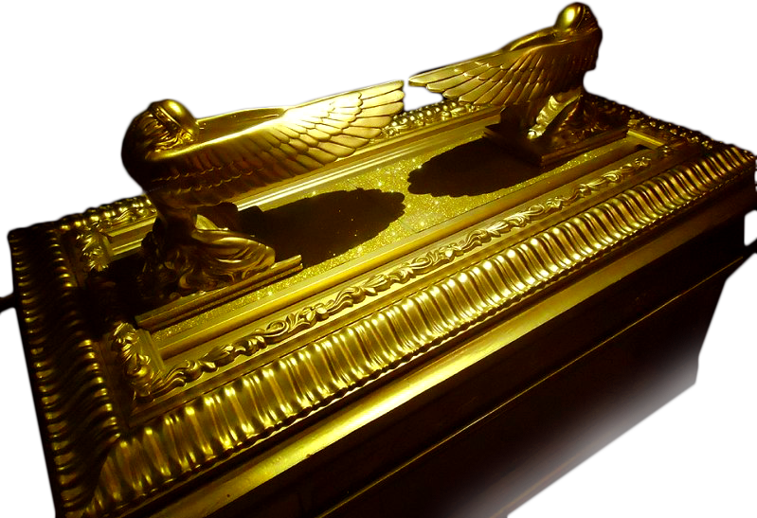
Mary as Ark of the New Covenant
God commanded the Israelites to build an ark, overlaid inside and out with the
purest refined gold to
hold their most Holy
and sacred items,
given them by God.
Notes:
So what is her relationship to the Ark of the Covenant?

Slide 5
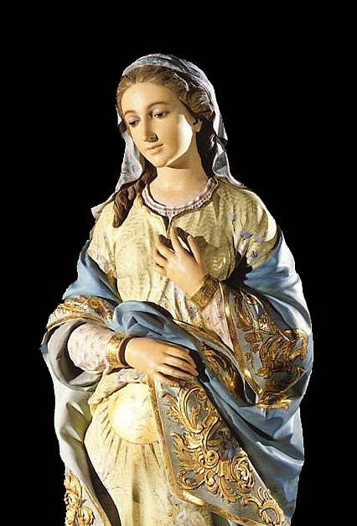
Mary as Ark of the New Covenant
Does it not make perfect sense then, that God would create a pure and holy vessel to contain His most precious Son?
Notes:
Mary, through her virginity and immaculate conception simply makes sense to be the Ark of the New Covenant.

Slide 6
Mary as Ark of the New Covenant
¹⁹ Then God’s Temple in heaven was opened, and the ark of his covenant could be seen in the temple. There were flashes of lightning, rumblings, and peals of thunder, an earthquake, and a violent hailstorm. – ¹ A great sign appeared in the sky, a woman clothed with the sun, with the moon under her feet, and on her head a crown of twelve stars.
Revelation 11:19 – Revelation 12:1
Notes:
Mary, the Ark of the New Covenant. This is the last verse of Revelation 11 and the first verse of Revelation 12, but remember that when they were written there was no division of chapter and verse, just a continuous writing like a blog or an essay today. A continuous thought.

Slide 7
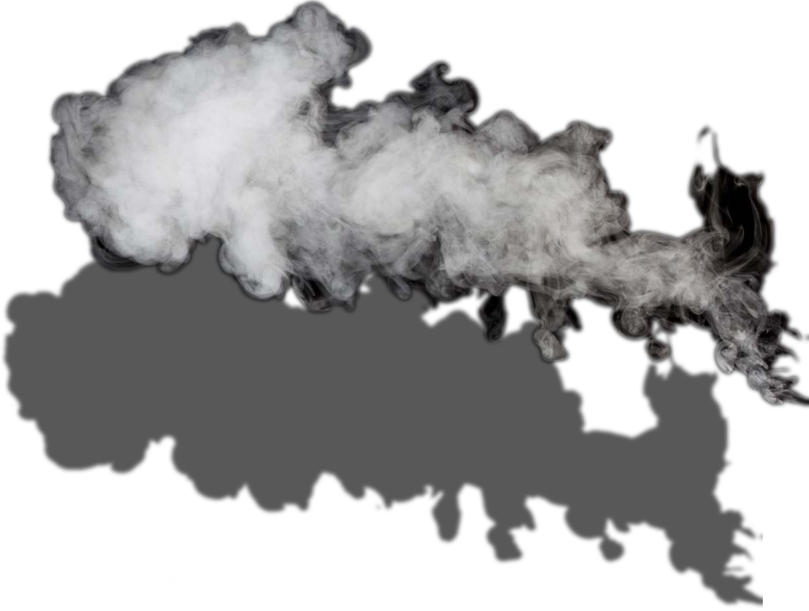
Mary as Ark of the New Covenant
Exodus 40:34
³⁴ Then the cloud overshadowed the tent of meeting, and the glory of the LORD filled the tabernacle [the place of the Ark of the Covenant].
Notes:
The Holy Spirit, or the Spirit of God is repeatedly referred to as a pillar of smoke or cloud, or as a cloud that overshadows to show Gods power.
In Exodus it overshadows the tent of meeting and the glory of the lord filled the tabernacle.

Slide 8
Mary as Ark of the New Covenant
1 Kings 8:10-11
³⁴ 10 When the priests left the holy place, the cloud overshadowed the house of the LORD ¹¹ so that the priests could no longer minister because of the cloud, since the glory of the LORD had filled the house of the LORD.
Notes:
In 1 Kings 8:10-11 it overshadows the house of the Lord. This passage is referring to the newly completed temple that Solomon had built in Jerusalem.

Slide 9
Mary as Ark of the New Covenant
Luke 1:35
³⁵ And the angel said to her in reply, “The Holy Spirit will come upon you, and the power of the Most High will overshadow you. Therefore the child to be born will be called holy, the Son of God.
Notes:
And the angel said to her in reply, “The Holy Spirit will come upon you, and the power of the Most High will overshadow you. Therefore the child to be born will be called holy, the Son of God.

Slide 10
Mary as Ark of the New Covenant
2 Samuel 6 | Luke 1
² Then David and all the people who were with him set out for Baala [a town] of Judah… | ³⁹ During those days Mary set out and traveled to the hill country in haste to a town of Judah,
⁹ David became frightened of the LORD that day, and he said, “How can the ark of the LORD come to me?” | ⁴³ And how does this happen to me, that the mother of my Lord should come to me?
¹⁰ David took the ark to the house of Obed-edom the Gittite. | ⁴⁰ where she entered the house of Zechariah and greeted Elizabeth.
¹¹ The ark of the LORD remained in the house of Obed-edom the Gittite for three months, | ⁵⁶ Mary remained with [Elizabeth] about three months…
¹² David went to bring up the ark of God from the house of Obed-edom into the City of David with rejoicing. | ⁴⁷ my spirit rejoices in God my savior.
¹⁵ David and all the house of Israel were bringing up the ark of the LORD with shouts of joy… | ⁴² [Elizabeth] cried out in a loud voice
¹⁶ As the ark of the LORD was entering the City… King David was leaping and dancing before the LORD… | ⁴¹ When Elizabeth heard Mary’s greeting, the infant (John the Baptist) leaped in her womb
Notes:
This one is for all you engineers…

Slide 11
Mary as Ark of the New Covenant
Luke 1:41-43
⁴¹ When Elizabeth heard Mary’s greeting, the infant leaped in her womb, and Elizabeth, filled with the holy Spirit, ⁴² cried out in a loud voice and said, “Most blessed are you among women, and blessed is the fruit of your womb. ⁴³ And how does this happen to me, that the mother of my Lord should come to me?
Notes:
Is this a contradiction, or inaccuracy in the scriptures? No, here is the problem: in the ancient languages of the Middle East, the Hebrew word אח or awkh was the only word used to describe male relatives. Every male in your immediate extended family was your brother. Likewise the word for sister was אחות or achoth and
In some translations, in Genesis 14:12, brother has been replace with nephew, and in verse 14 with kinsman, because even though the original word used was awkh or brother we know from chapter 11:27 that Lot is clearly the son of Abrams actual brother Haran, or Abrams nephew.
was used to describe all female relatives within your close extended family. There were no words to describe cousin, aunt, uncle, niece or nephew.

Slide 12
Mary as Ark of the New Covenant
Jesus, our Lord.
Jesus, the Word made flesh.
Jesus, deliverer of the New Covenant.
Mary, the Mother of God.
Mary, the Ark of the New Covenant.
Notes:
Is this a contradiction, or inaccuracy in the scriptures? No, here is the problem: in the ancient languages of the Middle East, the Hebrew word אח or awkh was the only word used to describe male relatives. Every male in your immediate extended family was your brother. Likewise the word for sister was אחות or achoth and
In some translations, in Genesis 14:12, brother has been replace with nephew, and in verse 14 with kinsman, because even though the original word used was awkh or brother we know from chapter 11:27 that Lot is clearly the son of Abrams actual brother Haran, or Abrams nephew.
was used to describe all female relatives within your close extended family. There were no words to describe cousin, aunt, uncle, niece or nephew.

Slide 13
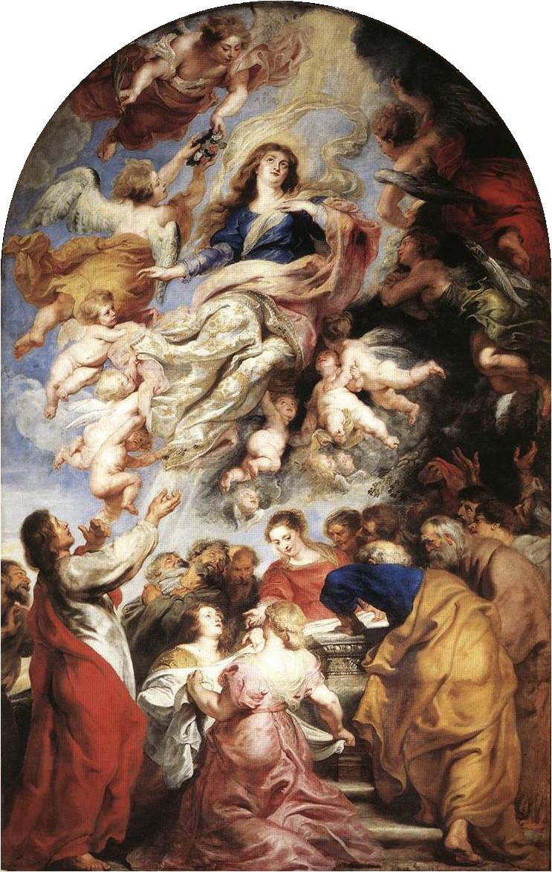
The Assumption of Mary
…“Mary had died in the presence of the apostles; but her tomb, when opened later . . . was found empty and so the apostles concluded that the body was taken up into heaven.”
Notes:
At the Council of Chalcedon in 451, when bishops from throughout the Mediterranean world gathered in Constantinople, Emperor Marcian asked the Patriarch of Jerusalem to bring the relics of Mary to Constantinople to be enshrined in the capitol. The patriarch explained to the emperor that there were no relics of Mary in Jerusalem, that “Mary had died in the presence of the apostles; but her tomb, when opened later . . . was found empty and so the apostles concluded that the body was taken up into heaven.”
THE ASSUMPTION OF MARY: A BELIEF SINCE APOSTOLIC TIMES by Father Clifford Stevens, “Catholic Heritage” Magazine, July-August 1996 Reprinted at www.ewtn.com/library/ANSWERS/AOFMARY.HTM

Slide 14
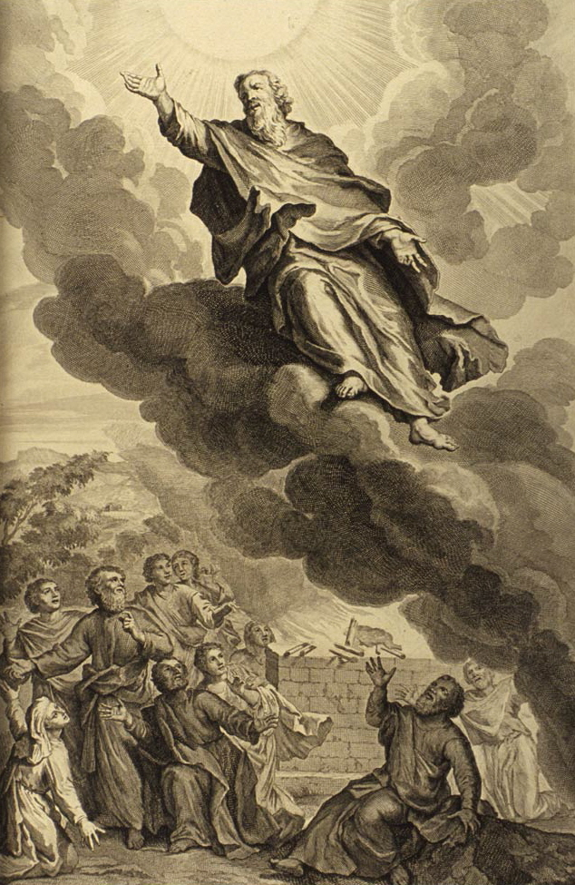
The Assumption of Mary
Enoch was taken up by God so that he might not see death.
Notes:
Enoch was taken up by God.

Slide 15
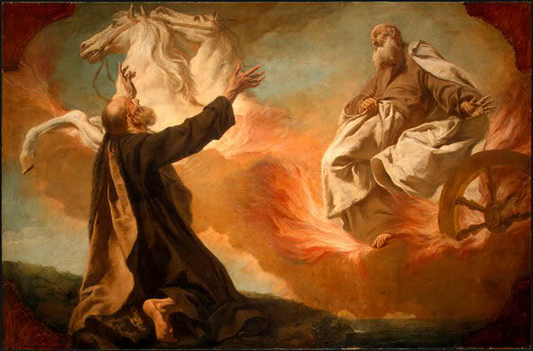
The Assumption of Mary
Elijah was taken up into Heaven in a fiery Chariot
Notes:
Elijah was taken into heaven in a fiery chariot.

Slide 16
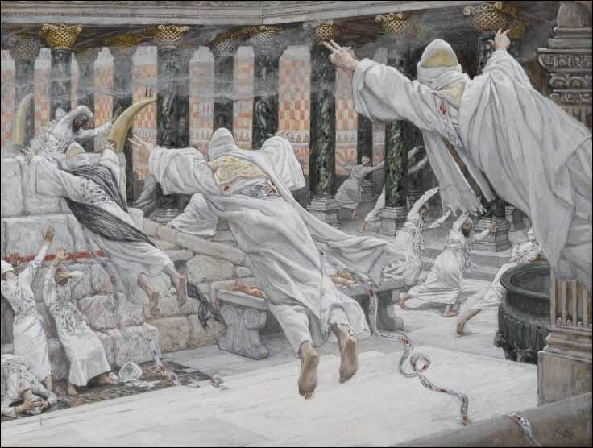
The Assumption of Mary
“⁵² tombs were opened, and the bodies of many saints who had fallen asleep were raised. ⁵³ And coming forth from their tombs after his resurrection, they entered the holy city and appeared to many.”
Matthew 27:52
Notes:
“⁵² tombs were opened, and the bodies of many saints who had fallen asleep were raised. ⁵³ And coming forth from their tombs after his resurrection, they entered the holy city and appeared to many.
Clearly many of the dead were raised before the second coming

Slide 17
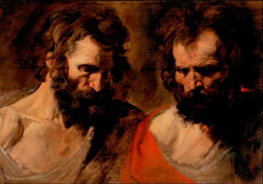
The Assumption of Mary
¹² Then they heard a loud voice from heaven say to them, “Come up here.” So they went up to heaven in a cloud as their enemies looked on.
Revelation 17:12
Notes:
Two witnesses sent by God were assumed into heaven body and soul into heaven before the return of Christ. If all of these major players could be assumed into heaven, there is no reason to believe that Mary, the most important woman ever born, could not have also been assumed body and soul into heaven to reside with her Son.

Slide 18
The Assumption of Mary
The assumption of Mary is NOT contrary to scripture.
If all of these major players could be assumed into heaven, there is no reason to believe that Mary, the most important woman ever born, could not have also been assumed body and soul into heaven to reside with her Son.
Notes:
If all of these major players could be assumed into heaven, there is no reason to believe that Mary, the most important woman ever born, could not have also been assumed body and soul into heaven to reside with her Son.
This is what the church teaches.
This is what I choose to believe.
966
“Finally the Immaculate Virgin, preserved free from all stain of original sin, when the course of her earthly life was finished, was taken up body and soul into heavenly glory, and exalted by the Lord as Queen over all things, so that she might be the more fully conformed to her Son, the Lord of lords and conqueror of sin and death.”

Slide 19
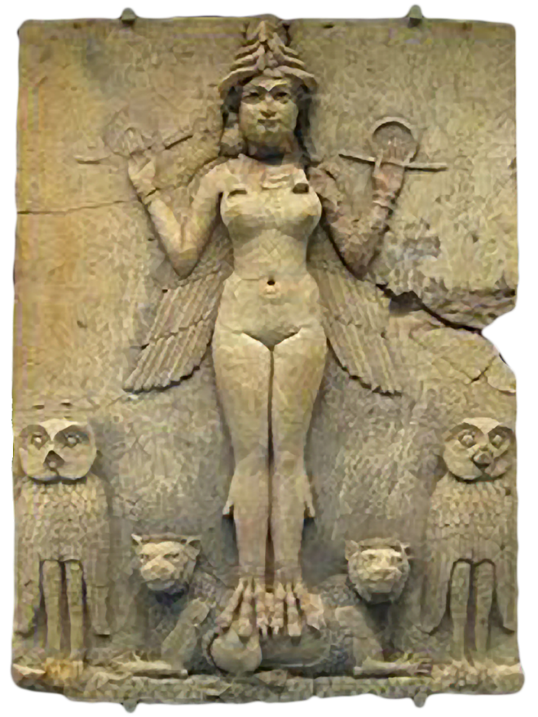
Mary, Queen of Heaven
Jerimiah 7:17-18 ¹⁷ Do you not see what they are doing in the cities of Judah, in the streets of Jerusalem? ¹⁸ The children gather wood, their fathers light the fire, and the women knead dough to make cakes for the Queen of Heaven, while libations are poured out to other gods—all to offend me!
A common passage used to refute the Queen-ship of Mary
Notes:
Of course as in many other passages, the full context must be appreciated to understand the message. Call her “Queen of Heaven” or call her a “God” it is the falseness of the worship that is offending to God, not the title.

Slide 20
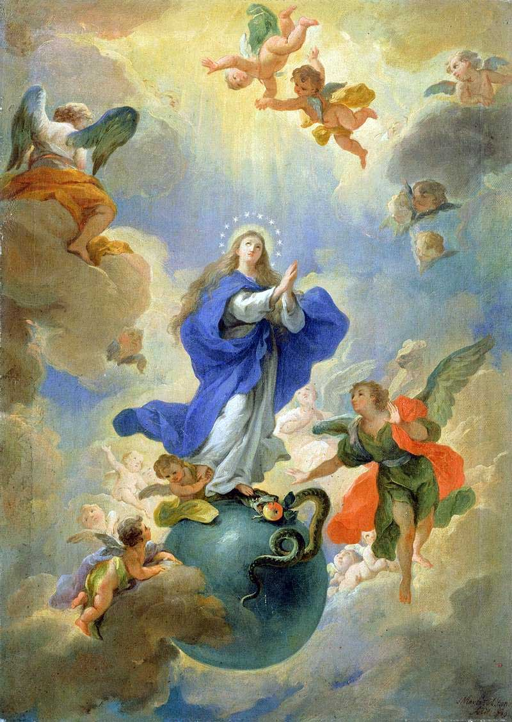
Mary, Queen of Heaven
First, let us be clear about what the Catholic Church means by the Queen-ship of Mary. Simply put, the Queen-ship of Mary refers to Mary’s royal dignity as Mother of the King of Kings, Jesus Christ. As we shall see, that title takes nothing away from Jesus’ own Kingship, but rather is a consequence of it.
Notes:
In his encyclical Ad Caeli Reginam (1954), Pius XII taught, "Certainly, in the full and strict meaning of the term, only Jesus Christ, the God-Man, is King; but Mary, too, as Mother of the divine Christ, as His associate in the redemption, in His struggle with His enemies and His final victory over them, has a share, though in a limited and analogous way, in His royal dignity" (no. 39). Pope Pius XII makes clear that royal dignity belongs "in the full and strict" sense to Jesus Christ alone. At the same time, Mary possesses a certain royal dignity by association with Christ in his Incarnation, Redemption and victory over evil.
Vatican II also affirmed Mary’s Queenship: "She was exalted by the Lord as Queen of all in order that she might be more thoroughly conformed to her Son, the Lord of Lords and the conqueror of sin and death" (Lumen Gentium 59; cf. Catechism of the Catholic Church, no. 966).
Mary’ Queenship is based on a number of elements. First, Mary's maternal relationship to Jesus, the King of Kings. Second, the Blessed Virgin's association with Jesus' work of redemption. Third, the royal dignity possessed by all members of the Church, including Mary, which is fully realized in heaven. This last element is, in a sense, an extension of Mary's association with Jesus, only under the aspect of her relation to the Church. Scriptural explanations of these points can help Protestants recognize Mary's royal dignity. “
From CatholicCulture.org, “Queen of Heaven: Pagan Divinity or Royal Mother of the Messiah?” by mark Brumley

Slide 21
Mary, Queen of Heaven
¹ A great sign appeared in the sky, a woman clothed with the sun, with the moon under her feet, and on her head a crown of twelve stars.
Revelation 12:1
A woman in heaven with a crown on her head. Surely, this is the Queen of Heaven.
Notes:
¹ A great sign appeared in the sky, a woman clothed with the sun, with the moon under her feet, and on her head a crown of twelve stars.
Revelation 12:1
A woman in heaven with a crown on her head. Surely, this is the Queen of Heaven.

Slide 22
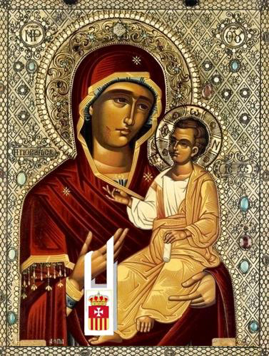
Mary, Queen of Heaven
⁵ She gave birth to a son, a male child, destined to rule all the nations with an iron rod. Her child was caught up to God and his throne.
Revelation 12:5
¹⁵ …He will rule them with an iron rod, and he himself will tread out in the wine press the wine of the fury and wrath of God the almighty. 16 He has a name written on his cloak and on his thigh, “King of kings and Lord of lords.”
Revelation 19:15-16
Notes:
Who else could this child be other than Jesus Christ? Destined to rule over the earth with an iron rod, and caught up to God and His throne!

Slide 23
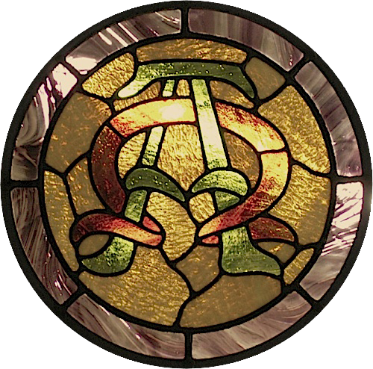
Mary, Queen of Heaven
⁸ I am Alpha and Omega, the beginning and the ending, saith the Lord, which is, and which was, and which is to come, the Almighty.
Revelation 1:8
Notes:
Who else could this child be other than Jesus Christ? Destined to rule over the earth with an iron rod, and caught up to God and His throne!

Slide 24
Mary, Queen of Heaven
The Alpha:
Geneses 3:15 15
¹⁵ I will put enmity between you [Satin] and the woman, [Mary] and between your offspring and hers [Jesus]; They will strike at your head, while you strike at their heel.
Notes:
Who else could this child be other than Jesus Christ? Destined to rule over the earth with an iron rod, and caught up to God and His throne!

Slide 25
Mary, Queen of Heaven
The Omega:
Revelation 12:17
¹⁷ Then the dragon [Satin] became angry with the woman [Mary] and went off to wage war against the rest of her offspring [Jesus and the faithful], those who keep God’s commandments and bear witness to Jesus.
Notes:
Who else could this child be other than Jesus Christ? Destined to rule over the earth with an iron rod, and caught up to God and His throne!

Slide 26
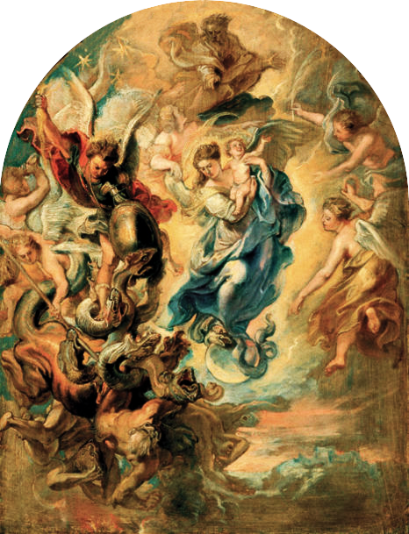
Mary, Queen of Heaven
Mary
Opens the Bible as the “Woman” in Genesis
Closes the Bible as the “Woman” in Revelation.
Notes:
Who else could this child be other than Jesus Christ? Destined to rule over the earth with an iron rod, and caught up to God and His throne!

Slide 27
Apologetics… Defending the Faith
Scripture in Support of Our Catholic Beliefs

